Slide 1
CS 4350: Fundamentals of Software Engineering CS 5500: Foundations of Software Engineering Lesson 6.1 Requirements and User-Centered Design
Jon Bell, John Boyland, Mitch Wand
Khoury College of Computer Sciences
© 2021 Jonathan Bell, John Boyland and Mitch Wand. Released under the CC BY-SA license

Slide 2
Outline of This Lesson
How do know what software should be built?
What does it mean for software to be usable?
How can we tell if we are building a usable product?
Image courtesy of Carnegie Mellon University
Human-Computer Interaction Institute

Slide 3
Learning Objectives for this Lesson
By the end of this lesson, you should be able to:
List the three main steps to determine requirements;
Describe the major aspects of usability;
Articulate the process of user-centered design;
Explain several heuristics for good user interaction.

Slide 4
Requirements
A three-step process:
Elicitation: Discover requirements from prospective customers.
Analysis: Understand and prioritize requirements elicited.
Validation: Bring back requirements to customer for confirmation.
Elicitation
Analysis
Validation
And Repeat!

Slide 5
Goal: Build the Right Product
If the product doesn’t do what the users want…
… we’ve wasted time and money.
If the product is not usable by the users…
… we will need to invest time/money to make it usable.
Users are often not sure exactly what they want,
… so we need to iterate the requirements process.
We shift development “to the left” (closer to user)
We correct mistakes
Before design, or else
Before coding, or else
Before debugging, or else
Before deployment.
The earlier,
The better!

Slide 6
“Usability”: a Definition
Usability is …
… a measure of how …
… an artifact …
... impacts …
… a human …
… with particular goals.
For us:
a software artifact
The goals are key!
6

Slide 7
Usability (1 of 5): Learnability
How easy is it to learn to use the artifact to accomplish a goal?
A “steep” learning curve requires a lot of expertise before one can achieve results.
Expertise
Result

Slide 8
Usability (2 of 5): Effectiveness
How often does the use lead to completion of a goal?
Is the artifact “fit for purpose”?

Slide 9
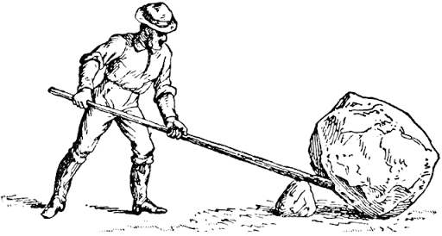
Usability (3 of 5): Productivity
How large a multiplier of human effort does this artifact give?
Does it make hard things easy? (or the reverse!)

Slide 10
Usability (4 of 5): Retainability
How long is the ability to use the artifact retained between uses?
Inner consistency can help mitigate a steep learning curve.

Slide 11
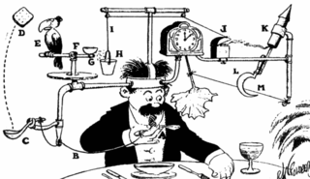
Usability (5 of 5): Satisfiability
How pleasant is the artifact to use?
Is it elegant and simple?

Slide 12
User-Centered Design
A system is evaluated from the user viewpoint.
Ideally by the users!
Tension: when do we evaluate?
An incomplete product may not be usable;
If a product is complete, using evaluation has cost.
Resolution: evaluate prototype!
Evaluate
Requirements
Develop
Prototype

Slide 13
Prototype (1 of 3): Paper Simulation
Hand-drawn user interfaces:
on paper or card;
made on the spot.
Developers animate:
Present to test user;
Users act:
Indicate what they would do.

Slide 14
Prototype (2 of 3): Wizard-of-Oz
Software has right “look”
But barely functional.
Scripted interaction only
All responses are “canned.”
Illusion is effective.

Slide 15
Prototype (3 of 3): Working Prototype
The software system partly implemented:
User interface fully realized;
Functionality limited.
Particularly for feature requests:
New feature can get quick-and-dirty implementation
Quickly get feedback if the right feature is implemented.
Comparison with TDD:
In TDD: feature request is realized in a test;
In UCD: feature request is realized in a user-interface.
In both cases, we delay implementation
until more understanding gained:
Move decisions closer to customers.

Slide 16
Forms of User Evaluation
Empirical evaluation
“How many tasks accomplished in N minutes?”
Qualitative evaluation
Observers find patterns in interaction;
Users give feedback after use.
”Dogfooding” (internal evaluation)
Developers use product as soon as feasible.
Heuristic evaluation
Evaluate against best practices.

Slide 17
Best Practice Heuristics (Nielsen)
“Discount ($) usability engineering methods”
Pioneered by Jakob Nielsen in the 1990s
Involves a small team of evaluators to evaluate an interface based on recognized usability principles
Heuristics–”rules of thumb”
Much cheaper than an
evaluation With ”real” users!
(Adapted from slides by Bonnie John and Jennifer Mankoff)

Slide 18
H1: Visibility of System Status
Interface should show:
What input has been received;
What processing is currently happening;
What results have already been completed.
This feedback allows
user to monitor progress towards solution of their task;
allows the closure of tasks; and
reduces user anxiety (Lavery et al).
Great podcast with interview with Brad Myers, creator/popularizer of progress bar in his 1985 PhD thesis (99 Percent Invisible 9/3/19)

Slide 19
H2: Match Between System and Real World
Speak the users’ language.
Follow real world conventions.
Don’t use internal jargon (“X.25 connection discarded”)
“Gray out” illegal options.

Slide 20
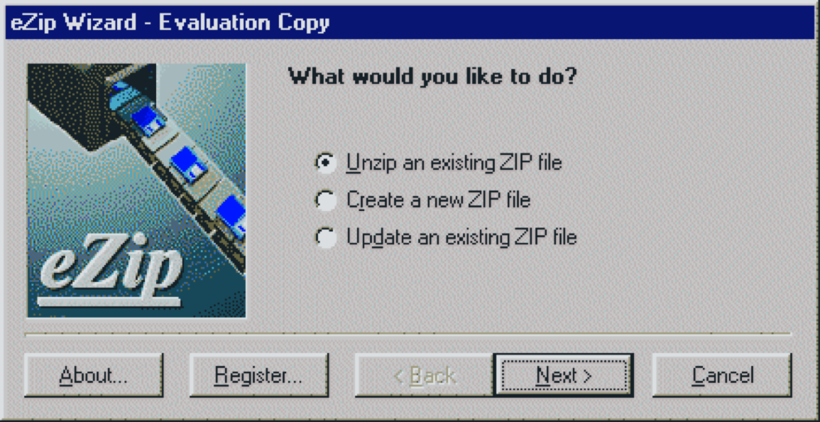
H3: User Control and Freedom
“Exits” for mistaken choices: undo, redo, cancel
Don’t force down fixed paths.

Slide 21
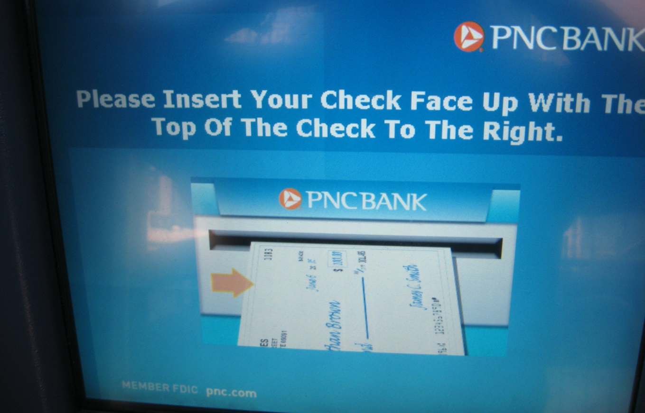
H4: Consistency and Standards
Same words, situations, actions, should mean the same thing in similar situations;
Same things look the same and be located in the same place.
Text consistent with figures.
Different things should be different.

Slide 22
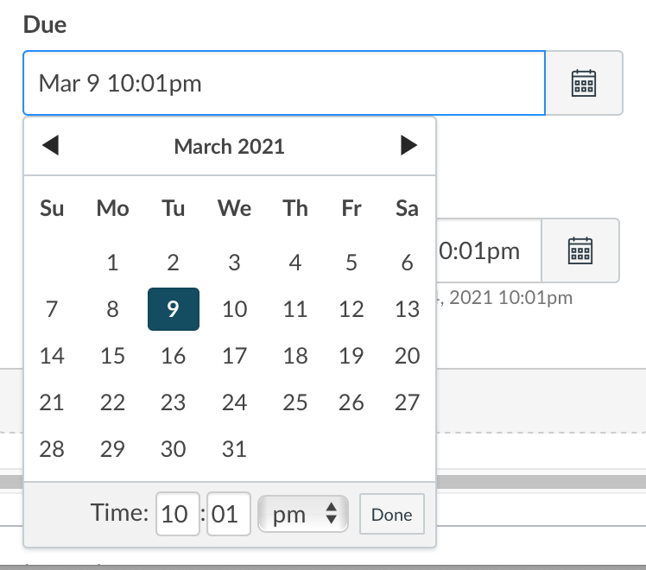
H5: Error Prevention
Careful design can prevent a problem from occurring in the first place.
It’s easier to point to a date on the calendar than to type it in the correct format.

Slide 23
H6: Recognition rather than Recall
Make objects, actions and options visible or easily retrievable.
It’s easier to pick out the channel we want to add than to enter the correct name.

Slide 24
H7: Flexibility and Efficiency of Use
Accelerators for experts (e.g., gestures, kb shortcuts)
Allow users to tailor frequent actions (e.g., macros)

Slide 25
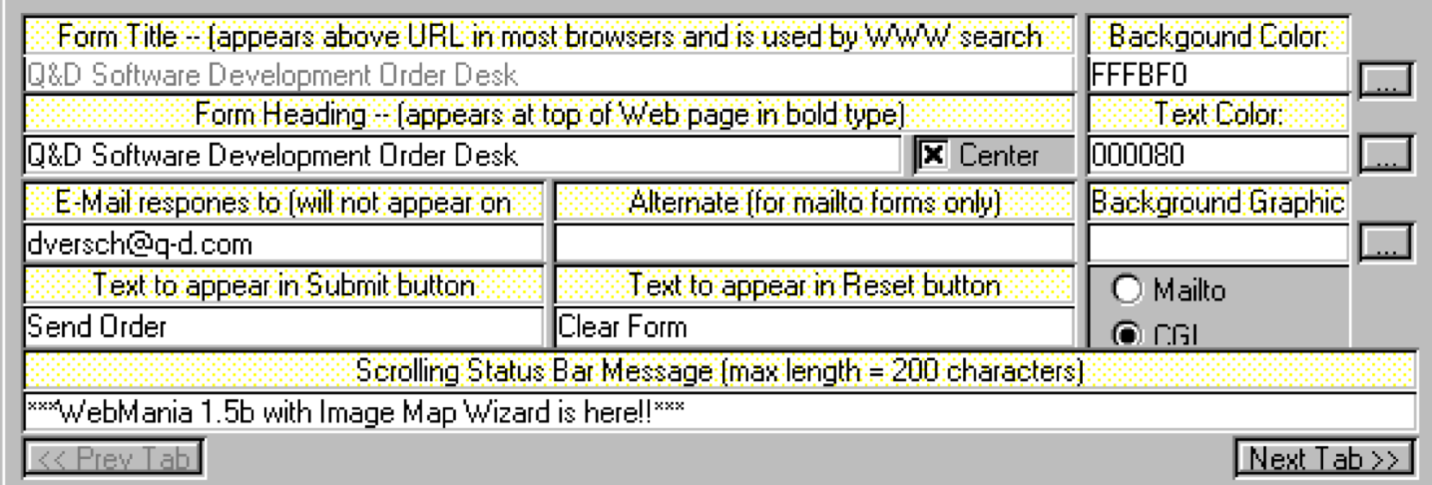
H8: Aesthetic and Minimalist Design
Interfaces should not contain irrelevant or rarely needed information.

Slide 26
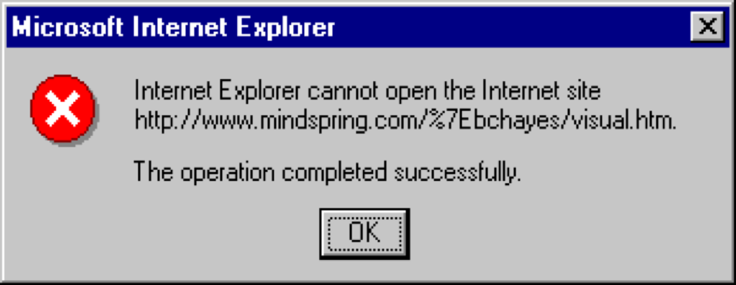
H9: Help users recognize, diagnose, and recover from errors
Use standards to convey errors;
Error messages should be in language user will understand;
Precisely indicate the problem;
Constructively suggest a solution.

Slide 27
H10: Help and Documentation
Should be
Easy to search;
Focused on the user’s task;
List concrete steps to carry out;
Always available.

Slide 28
Review: Learning Objectives for this Lesson
You should now be able to:
List the three main steps to determine requirements;
Describe the major aspects of usability;
Articulate the process of user-centered design;
Explain several heuristics for good user interaction.

Slide 29
Looking forward…
In the next part of Lesson 6, we describe React, a user-interface architecture.

